Slide 1
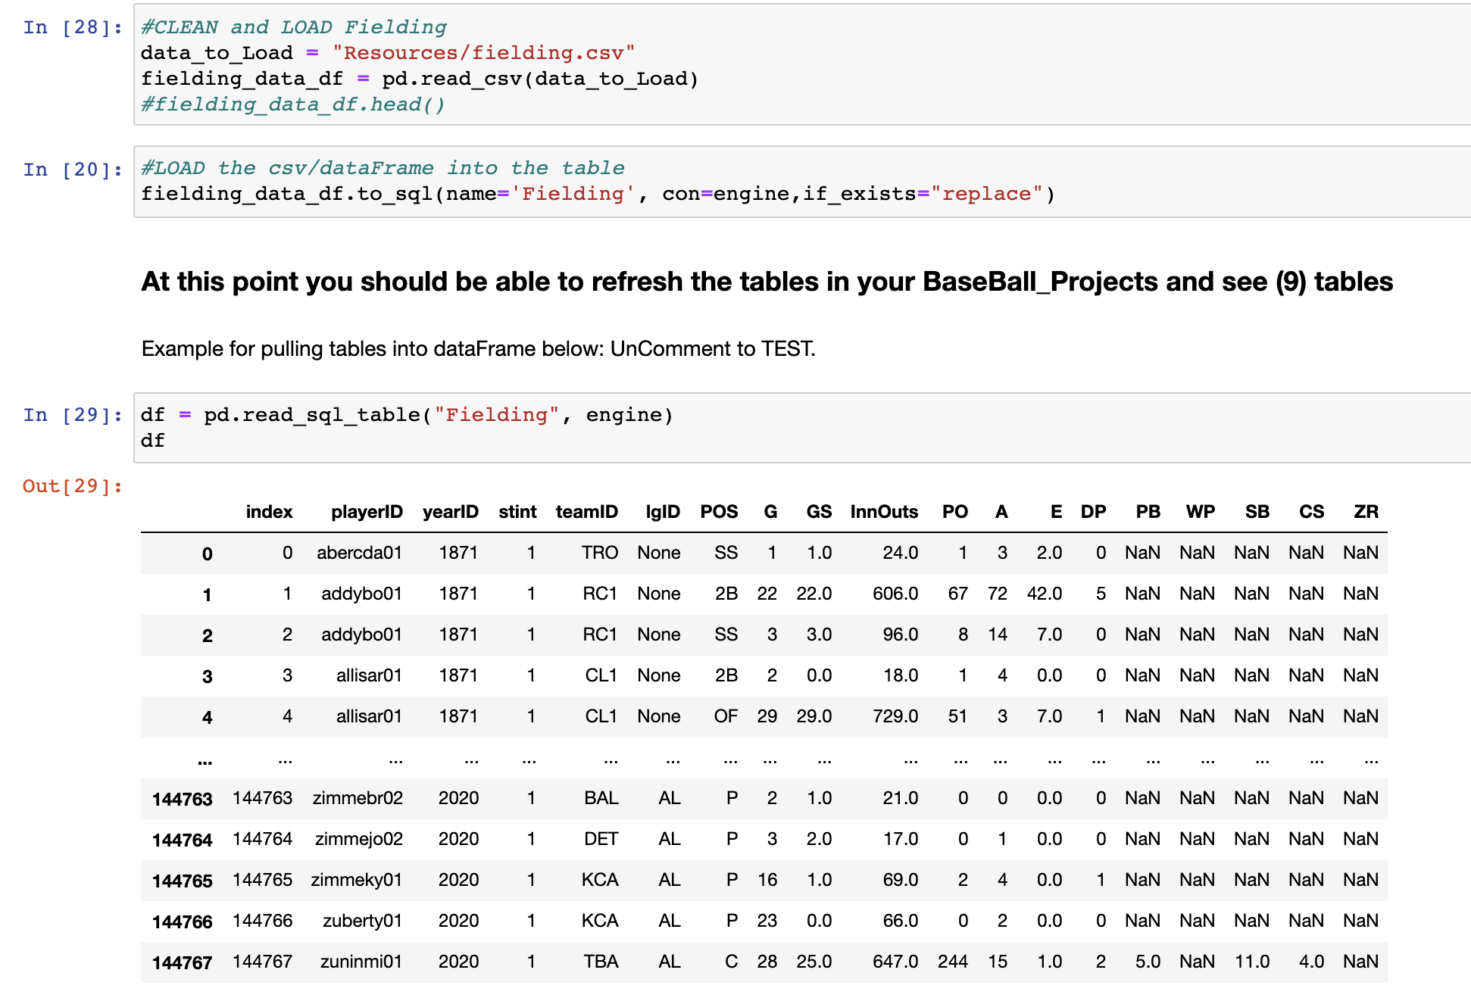
Database Implementation
The below image illustrates implementing the database through a jupyter notebook.

Slide 2
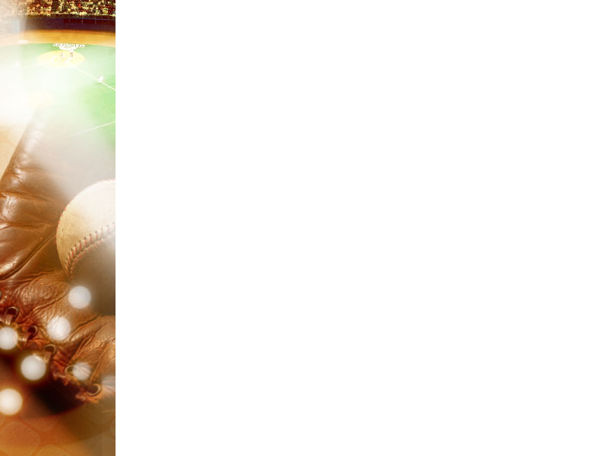
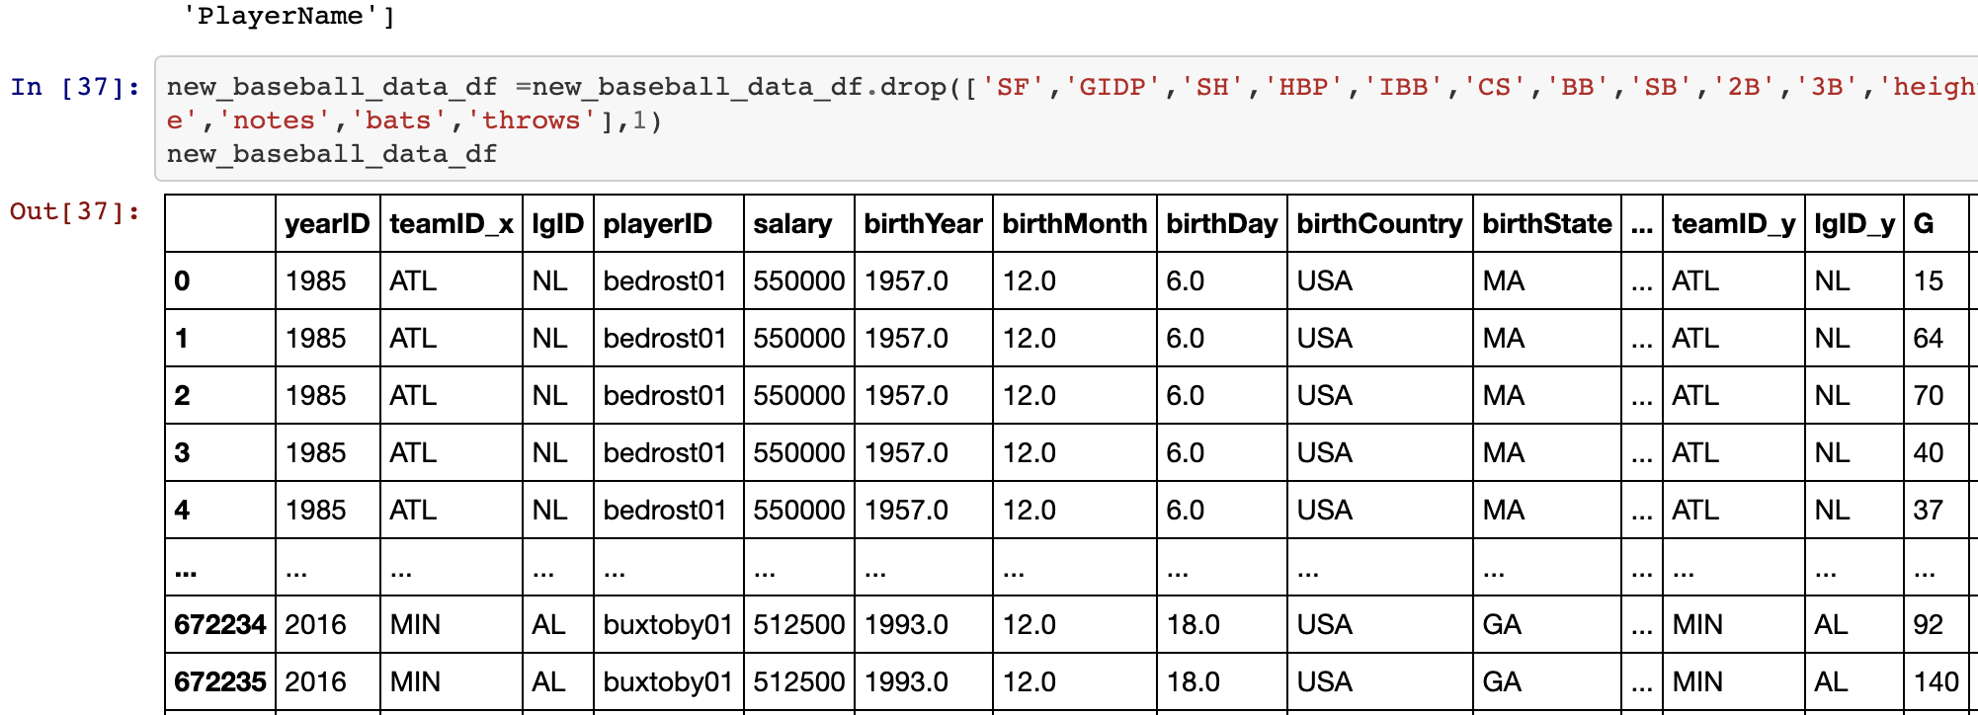
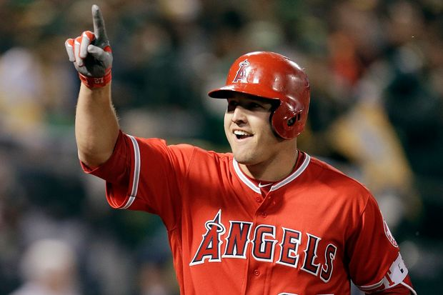
Machine Learning Model
Through pre-processing the data, we chose supervised learning via a Random Forest Model. Below is an example of narrowing down data by dropping columns.
We chose to base our data on Mike Trout’s core statistics.
Four-Time American League MVP Mike Trout
Notes:
The Random Forest Model uses classification to predict based on our salary target and our features which are year, team, stats (like strikeouts), and birth year. By pairing down the data, through combining and cleaning the csv files, it really dialed in to the details of what we wanted to measure.
Basing the main measures on Mike Trout's core statistics(SO,AB,R,H,HR,G,R and RBIs), we used his metrics as a baseline to look for when deciding our final goal. Also, including the ‘awardID’, which shows which award each player won, and ‘lgID’, which shows the league in to see if that had any impact.
Then the Random Forest Model interprets this information and gives an accuracy score based on what is the most impactful in deciding the salary of a player. The confusion matrix and list of importances each show the logic behind what determines how much to pay each player.
How does it work?
This model works by first understanding our decision tree. Through pre-processing the data, we chose supervised learning via a Random Foreast Model to get our desired answer of building a baseball team and what we should have as our base information when in choosing a player. The Random Forest Model uses classification to predict based on our salary target and our features which are year, team, stats (like strike outs), and birth year. By pairing down the data, through combining and cleaning the csv files, it really dialed in to the details of what we wanted to measure. Basing the main measures on Mike Trout's core statistics(SO,AB,R,H,HR,G,R and RBIs), I used his metrics as a baseline to look for when deciding our final goal. Also, including the awardID, which shows which award each player won, and lgID, which shows the league in to see if that had any impact. Then the random forest model interprets this information and gives an accuracy score based on what is the most impactful in deciding the salary of a player. The confusion matrix and list of importances each show the logic behind what determines how much to pay each player.
Why this specific model?
We wanted to use this supervised learning because we wanted to see the weighted importances that go into building a team based on salary. The salary was really the base in showing how much a player is worth based on factors like stats, year they were born, and year they played baseball.

Slide 3
Technology & Tools
Collaboration
Github
Github Desktop
Slack
Coding & Data Management
Jupyter Notebook
pgAdmin
Presentation
Tableau Public
Microsoft PowerPoint
Analysis Tools & Languages
Python Pandas
Matplotlib
Tableau
NumPy
SciPy
RandomForest

Slide 4
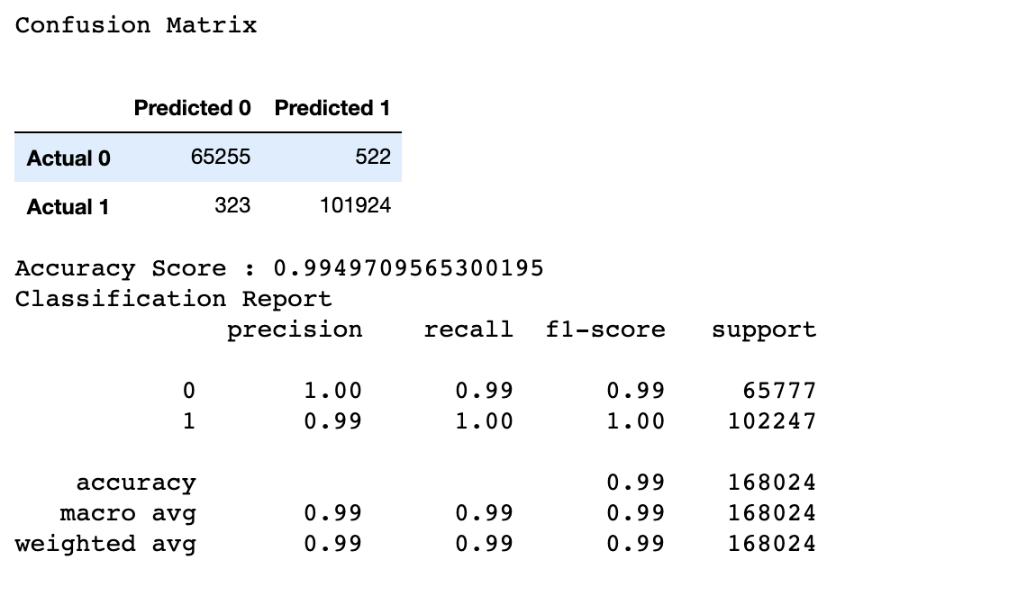
Answering Questions
Can we build a model to predict whether a player will command a premium salary based on their demographics & statistics?
In the confusion matrix below, we can see with 99% accuracy score, the model identified either a salary above $2M was a premium salary which were true negatives, or below $2M as true positives.
Notes:
Our original goal was to have a models accuracy at 80% or higher. We did accomplish that with 99% accuracy. There are some duplications just because there are some players who performed in multiple years, which can increase the accuracy of the data. Upon discussion, removing the multiple years and only have one year would not really give the data for anything other than salary because those individual stats and team stats.

